Slide 1
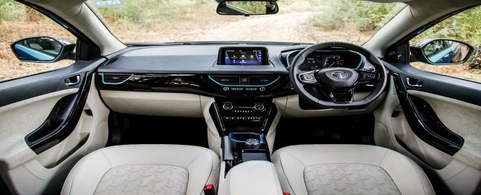
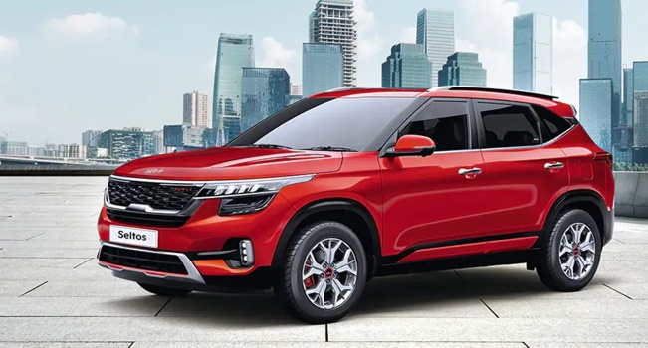
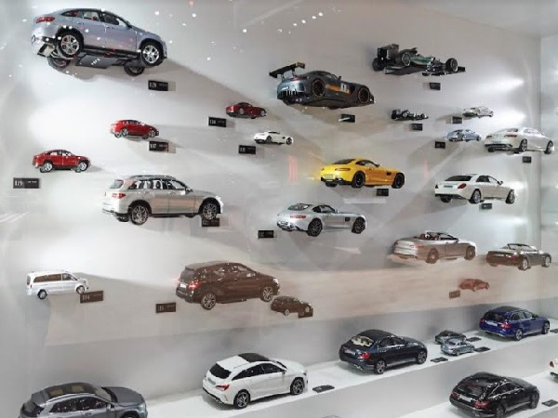
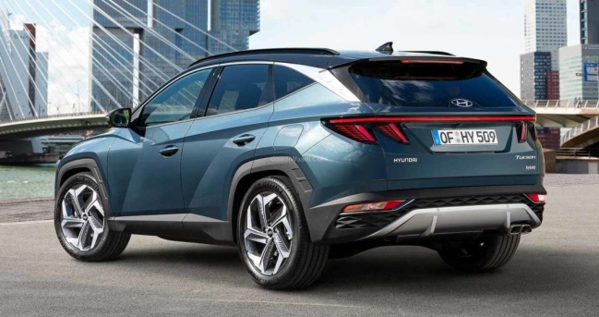
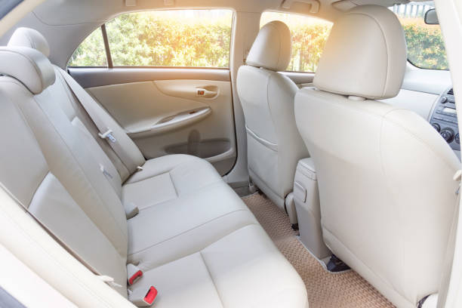
CARS FOR TEST DRIVE
DONE BY
SHAFREEN KHAN
RAMYA

Slide 2
INTRODUCTION
In this project, the client need not visit any car showroom, one can book a car for test drive within the comfort of their home.
Our website consists of cars of 4 different companies with their cost and features.
One can compare and book a car for test drive anytime.

Slide 3
EXISTING SYSTEM
When you plan on buying a new car, even after hours of research, you must have your choice of model is the right one. In this regard, test driving your shortlisted vehicle can clear the air of confusion.
For a seamless experience, you might want to consider following certain steps while test driving your choice of car. Here are the steps to follow:
Shortlist the car for a test drive.
Test drive the correct model and variant you are considering buying.
Ensure you have sufficient time. Choose a location and time at your convenience.
Carry certain items like CDs or USB drives to check the music system of your new car.
Apart from following the steps, a successful test drive requires you to carry a checklist of pointers you must inspect before, during and after the test drive.

Slide 4
TOOLS USED
FRONT END : HTML.CSS
BACKEND : MYSQL

Slide 5
What to Check in a Test Drive for a Car?
Before you know how to take a test drive of a car, here are some things you might consider checking:
Take a walk around and inspect the overall appearance of the car.
Check panel gaps; door handles, overall fit and finish, build quality etc.
Inspect the inside boot space, its dimensions etc.Check how wide the front and rear doors open.
Ensure the car offers comfort during getting in and out.Observe the leg and headroom in the car’s rear.
Ensure you get maximum comfort while sitting in the front.
After this preliminary check, you might want to consider some further checks in detail before test driving the car. Here are the checks to follow:
Examine the various compartments, adjust dials and push buttons in the car.
Inspect your steering wheel adjustability, driving position, foot pedals, etc., and ensure overall comfort considering traffic congestion.
Examine driver’s visibility, seat height adjustment etc. and make sure the safety features are intact.
Now that you have completed the initial checks, you can proceed to test driving your car. Nevertheless, during the test drive, you might consider undertaking the following inspections:
Change the type of route and duration of the drive as per your requirement to check the car’s performance.Check your car’s braking efficiency.
Examine the engine and acceleration.Notice the mirrors for proper visibility.
Drive your car at various speeds in different gears to check cabin noise, vibrations and harshness, tyre noise etc.Check how smoothly you can move the clutch.
Examine the riding performance on a rough road.
While reversing your car, check the rear visibility.
Inspect the aircon system or blower noises at various speeds.
Finally, after you complete the test drive, you can discuss any doubts with the representative. In addition, if you are still unsure about your choice, you can book another test drive.

Slide 6
DESCRIPTION
HTML
HTML stands for Hyper Text Markup Language. HTML is the standard markup language for creating Web pages
CSS
CSS stands for Cascading Style Sheets. CSS describes how HTML elements are to be displayed on screen, paper, or in other media
MYSQL
MySQL is a database system used on the web. MySQL is a database system that runs on a server. MySQL is ideal for both small and large applications

Slide 7
WORKING
First a homepage is created.
Homepage consists of various cars companies like KIA,RENAULT,TATA,HYUNDAI eg:KIA
In 2nd page after the selection of car company it shows all the avaliable cars for sale eg:Seletos,Sonet,Carens.
In 3rd page after we select a car it shows all the details Features and Varients including price eg:Sonet
In 4th page an Pop up form page will be open for booking test drive a car at the location your confortable.
Our website form consists of customer Name,Ph.no,Address,Email.id,Proof etc..

Slide 8
ADVANTAGES
Our Website project will be very usefull for :
Senior citizens,
Office employees,
Doctors etc..
It Saves time and Reduces travel expenses.
We have an Offroad Experiences
Our Comfortability location booking for Testdrive.
Having free time to discuss it with sellers.

Slide 9


